Slide 1

one microtask
primes another
Edward Newell
Derek Ruths
Network Dynamics Group
McGill University

Slide 2
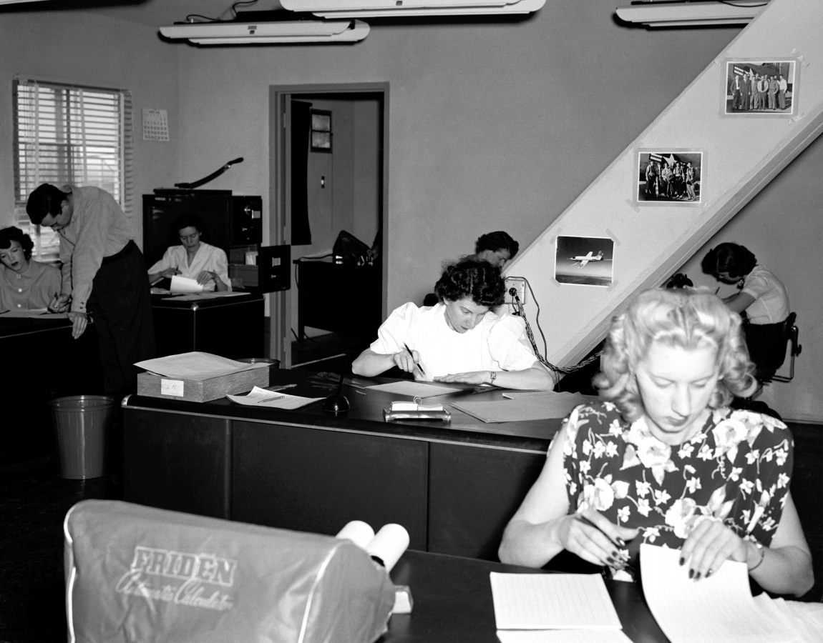
Notes:
NASA’s Dryden flight research center, summer 1949, Lilly Ann Bajus

Slide 3


Slide 4
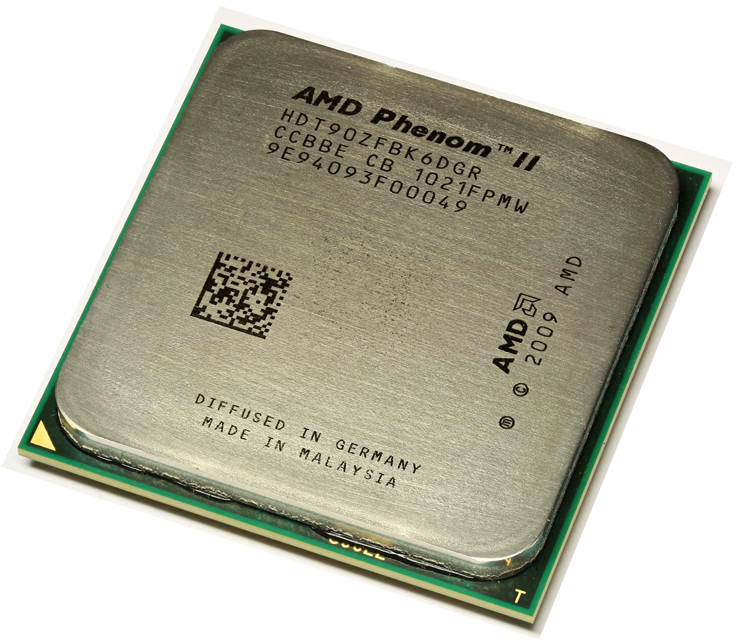
CPU

Slide 5
CPU
HPU
?

Slide 6
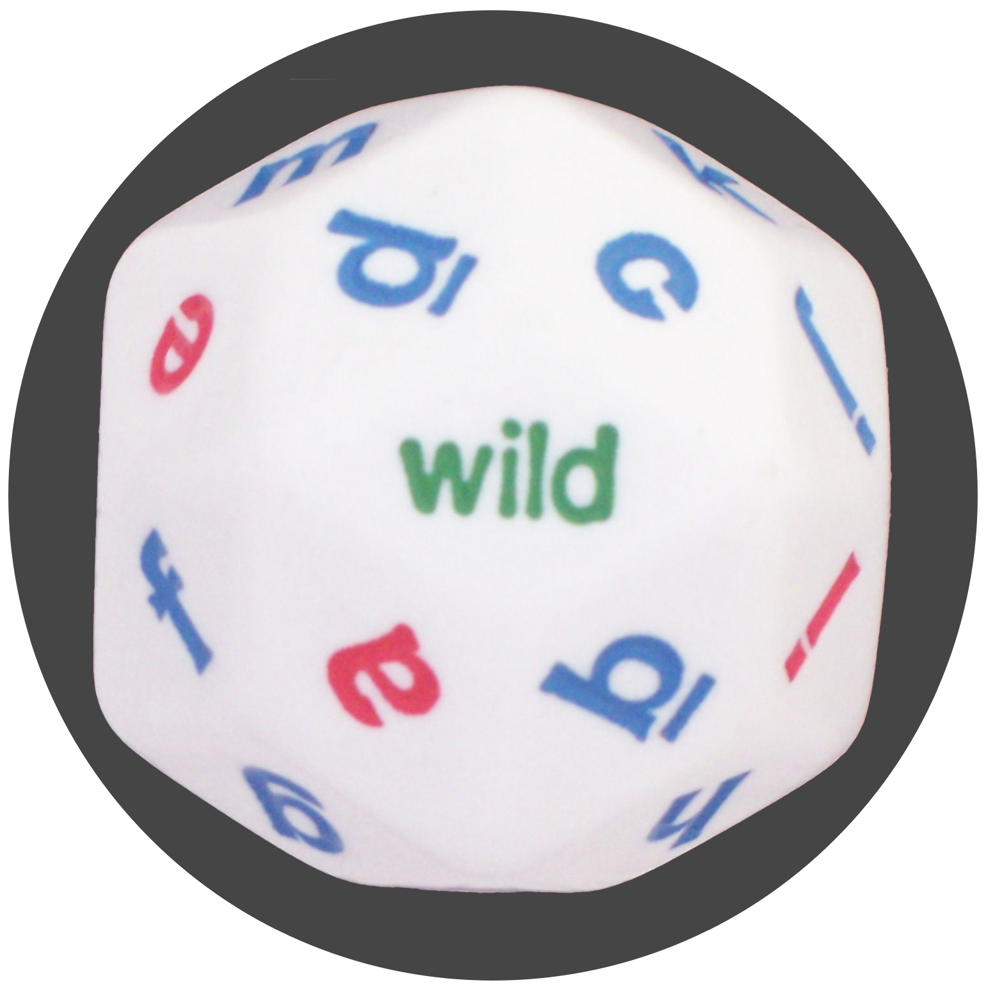
CPU
HPU
?

Slide 7


Slide 8
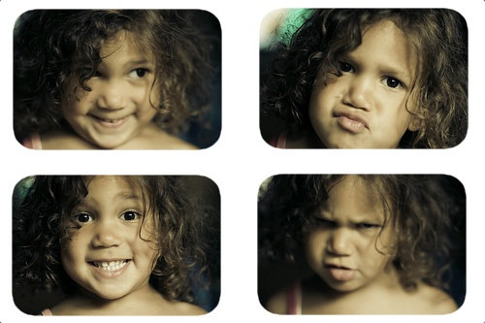

Slide 9
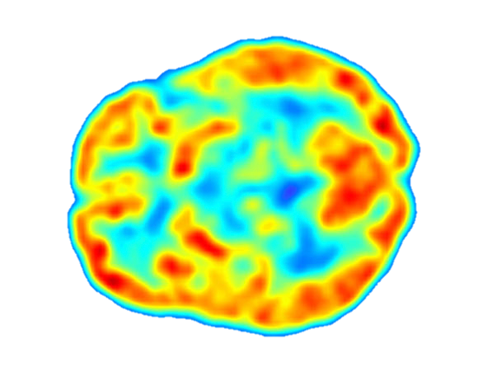

Slide 10
Variance
Stochastic
Systematic

Slide 11
Variance
Stochastic
Systematic
Selection
Priming

Slide 12
Variance
Stochastic
Systematic
Selection
Priming
framing
inter-task
effects

Slide 13
Priming
?
?
?
Psychological
Computational

Slide 14
Priming can be strong

Slide 15
Priming can be strong
“Crime is a beast ravaging the city of Addison...”
“Crime is a virus ravaging the city of Addison...”
1. Rank the following solutions:
…

Slide 16
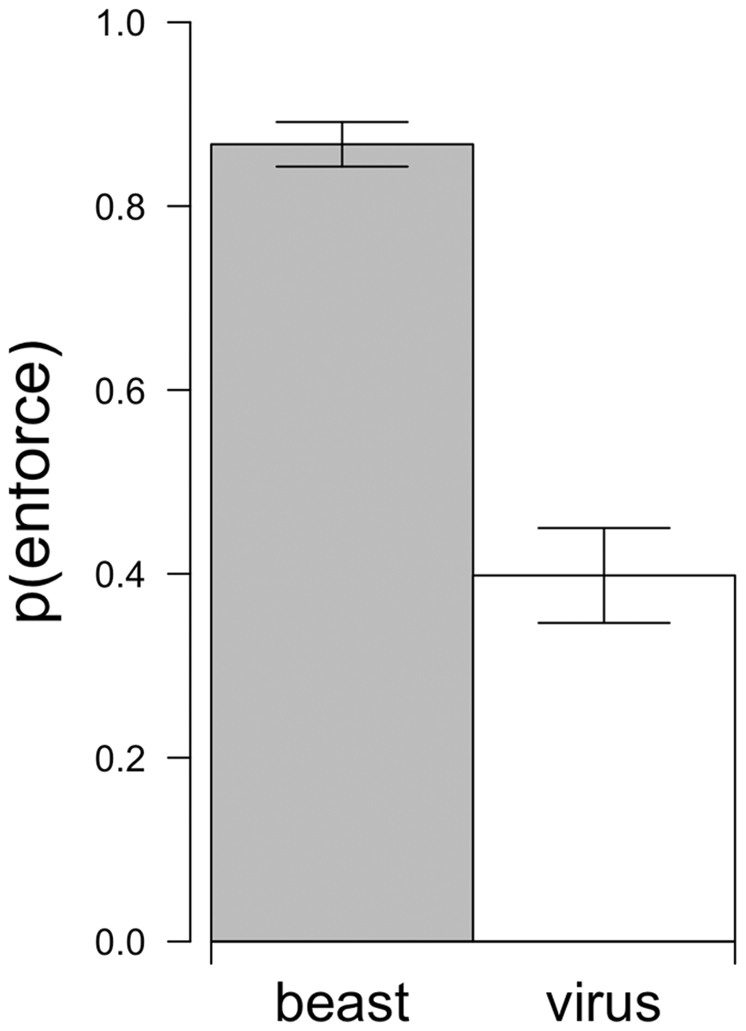
Priming can be strong

Slide 17
Can early tasks prime later ones?

Slide 18
Can early tasks prime later ones?
A series of image labeling tasks
food
mixed
object

Slide 19
Can early tasks prime later ones?

Slide 20
How to measure priming?
R

Slide 21
How to measure priming?
R
prime
δ⁺
δ⁻

Slide 22
How to measure priming?
R
prime
δ⁺
δ⁻
task
T
T

Slide 23
How to measure priming?
R
prime
δ⁺
δ⁻
task
T
T
output
P
Q

Slide 24
How to measure priming?
D(P,Q)

Slide 25
How to measure priming?
D(P,Q)
?

Slide 26
How to measure priming?
D(P,Q)
?
χ² (chi squared)

Slide 27
How to measure priming?
D(P,Q)
?
χ² (chi squared)
Kulback-Liebler
Shannon-Jenson
L₁-distance

Slide 28
How to measure priming?
hpu output
a binary decision

Slide 29
How to measure priming?
hpu output
a binary decision

Slide 30
How to measure priming?
hpu output
a binary decision

Slide 31
How to measure priming?
hpu output
“ bias ”
a binary decision

Slide 32
How to measure priming?
How should priming be measured?
if( ) {
…
} else {
…
}

Slide 33
How to measure priming?

Slide 34
How to measure priming?

Slide 35
How to measure priming?
find the most susceptible decision

Slide 36
How to measure priming?
find the most susceptible decision
“max bias”

Slide 37
How to measure priming?
max bias

Slide 38
How to measure priming?
max bias
L₁-distance

Slide 39
How to measure priming?
max bias
L₁-distance
accuracy of best classifier

Slide 40
Inter-task effects
T₁
T₂
prime?

Slide 41
Inter-task effects
food pics
inter-task
object pics
“ food ”
framing
“ objects ”

Slide 42



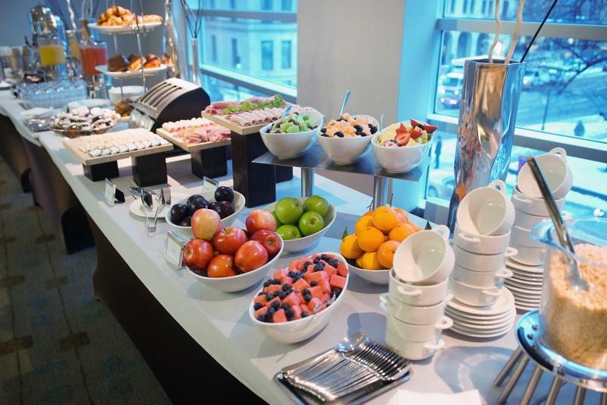

Test tasks

Slide 43
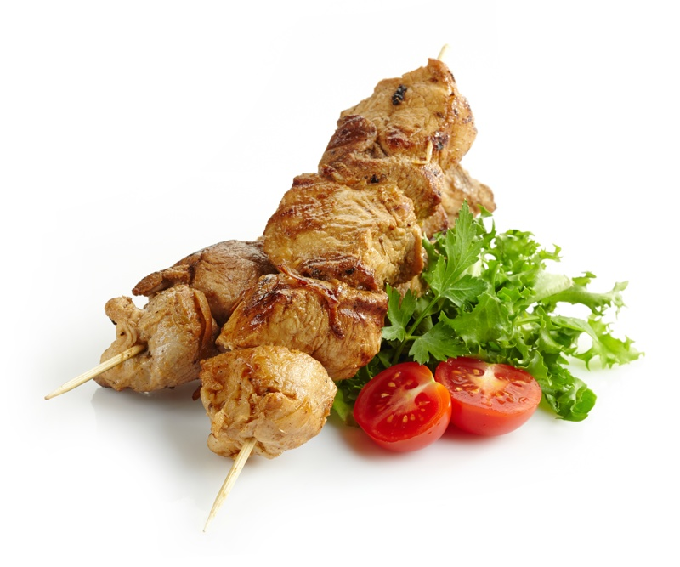
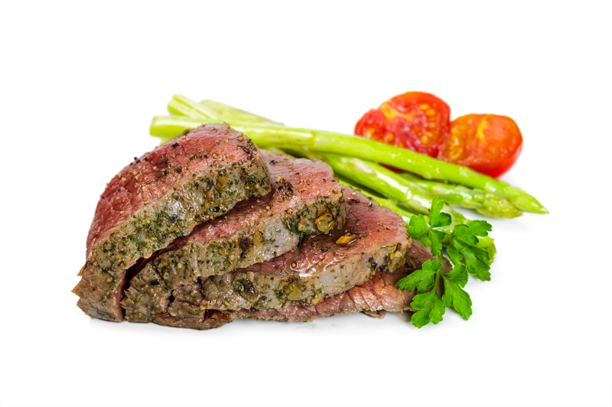
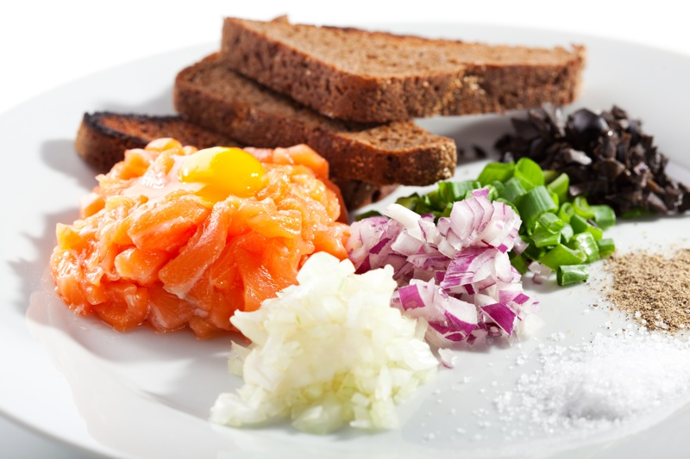
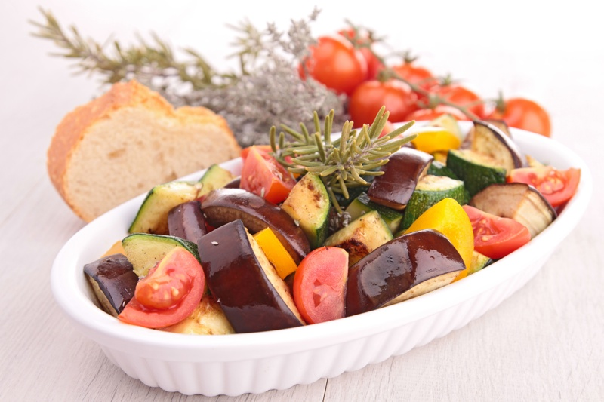
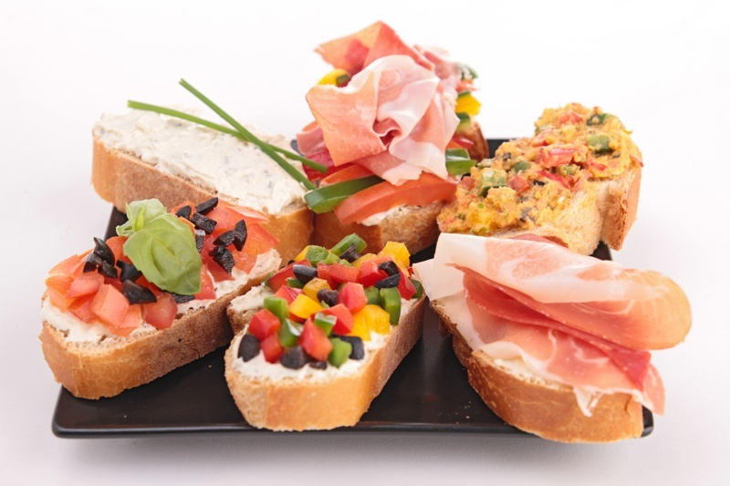
Initial tasks: food

Slide 44





Initial tasks: objects

Slide 45
Framing
The purpose of this study is to understand the visual perception of
Food and Ingredients
The purpose of this study is to understand the visual perception of
Objects and Tools

Slide 46
Inter-task effects: stronger than framing

Slide 47
Inter-task effects: decay over time

Slide 48
Inter-task effects: decay over time
spontaneous re-priming

Slide 49
Inter-task effects

Slide 50
Inter-task effects: direct focus

Slide 51
Measuring priming
classifier = difference detector
application-independant
interpretation: max bias
Inter-task effects
stronger than framing
significant 5 tasks later
spontaneous re-priming
alter specificity

Slide 52
Jenson-Shannon Divergence

Slide 54
References

Slide 55
References

Slide 56
References

Slide 57
References

Slide 58
References

